Slide 1
Deformable Convnets and Optical Flow
John Shin, Jacob Portes, Nicholas Sparks
Team 6 - April 30, 2019

Slide 2
Can DCNs improve optical flow estimates?

Slide 3
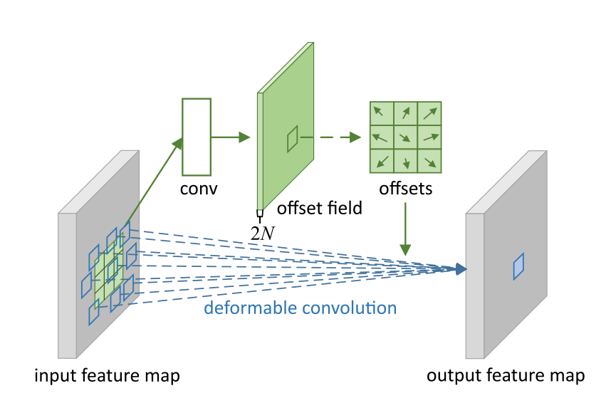
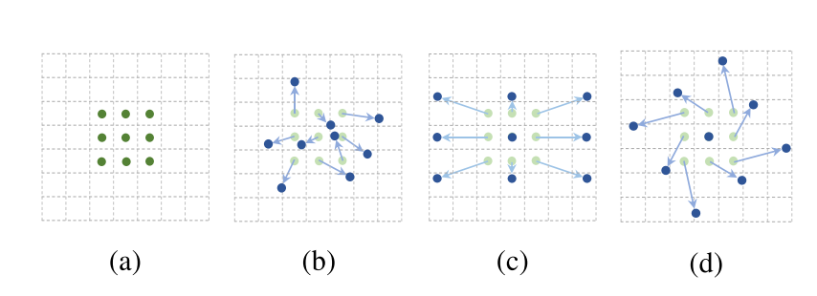
Background: Deformable Convnets (DCNs)
Dai, Jifeng, et al. "Deformable convolutional networks." Proceedings of the IEEE international conference on computer vision. 2017.
Zhu, Xizhou, et al. "Deformable convnets v2: More deformable, better results." arXiv preprint arXiv:1811.11168(2018).
Notes:
augmenting the spatial sampling locations ---> additional offsets

Slide 4
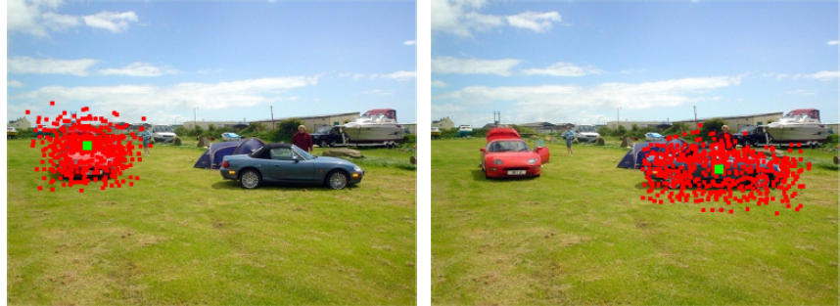
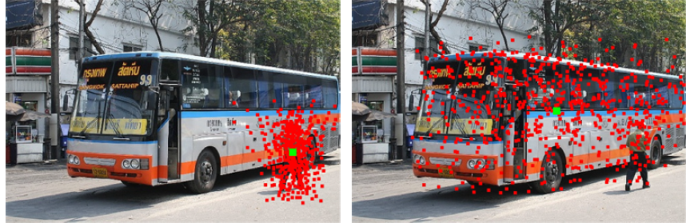
Background: DCNs for object detection/segmentation
Notes:
Semantic segmentation
Object detection

Slide 5
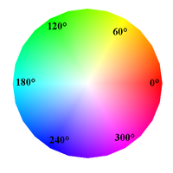
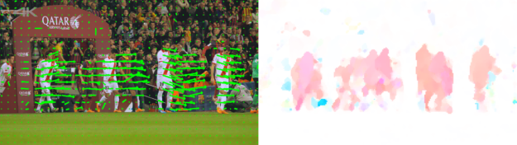
Background: Optical Flow
Loss = EPE = End Point Error (root MSE)
Notes:
relationship between two frames,--> where each pixel moves from one frame to the next

Slide 6
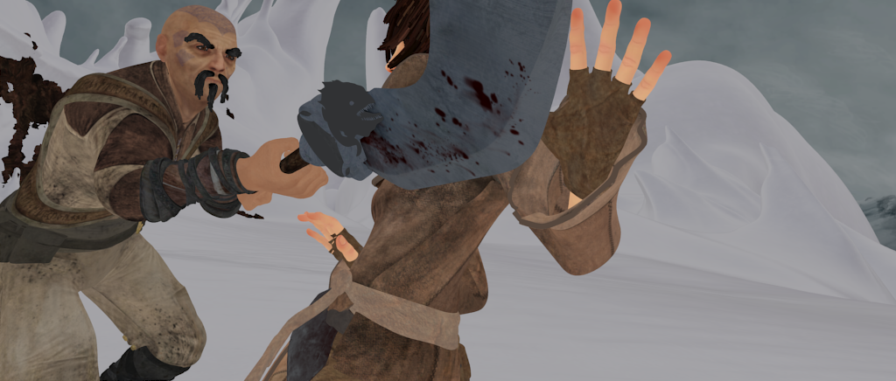
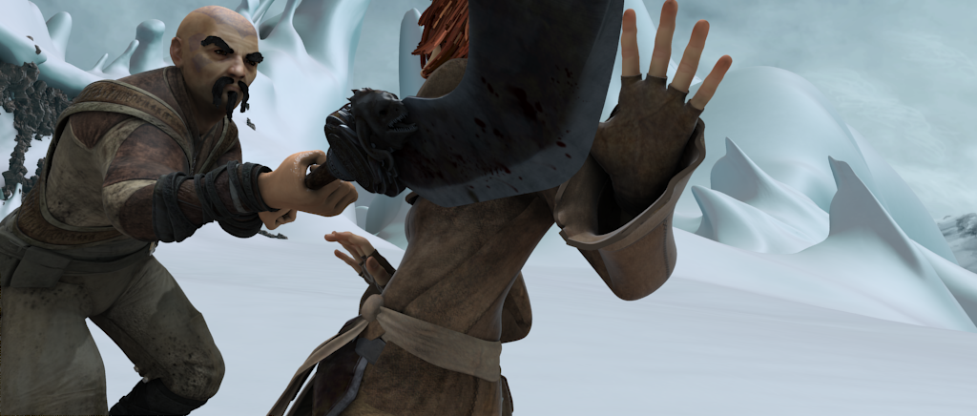
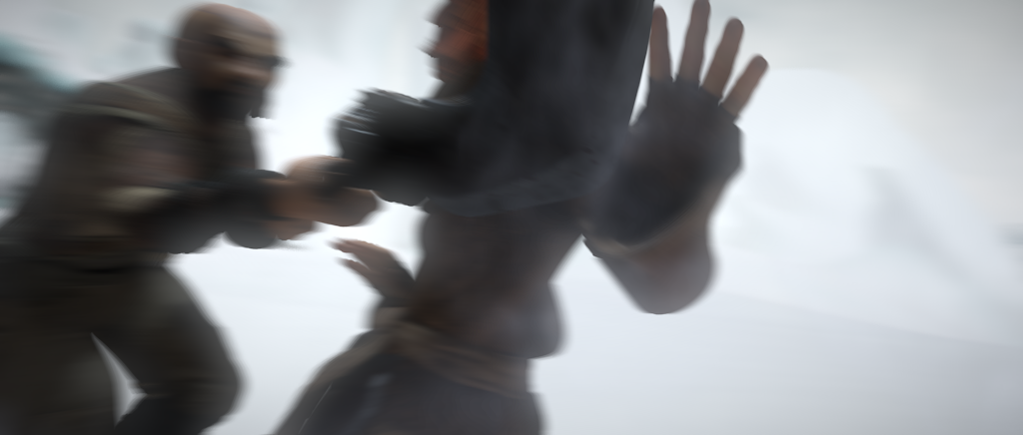

MPI-Sintel Benchmark
ALBEDO (no shading, no blur)
CLEAN (no blur)
albedo (no shading or motion blur)
clean (no motion blur)
final (motion blur, shading, depth blur)
FINAL
GROUND TRUTH
http://sintel.is.tue.mpg.de/
Notes:
The MPI-Sintel Dataset and Benchmark is based off an animated movie, “Sintel.” This movie was created in Blender, and has varying types of data to train with. There is the

Slide 7
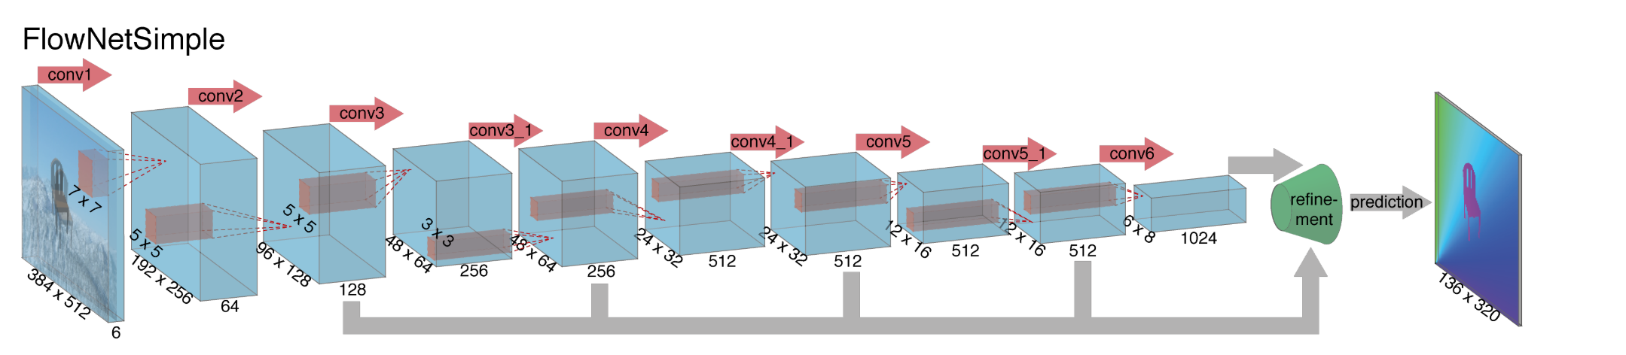
FlowNet and FlowNet2
Where it began...
Dosovitskiy, Alexey, et al. "Flownet: Learning optical flow with convolutional networks." Proceedings of the IEEE international conference on computer vision. 2015.
Ilg, Eddy, et al. "Flownet 2.0: Evolution of optical flow estimation with deep networks." Proceedings of the IEEE conference on computer vision and pattern recognition. 2017.

Slide 8
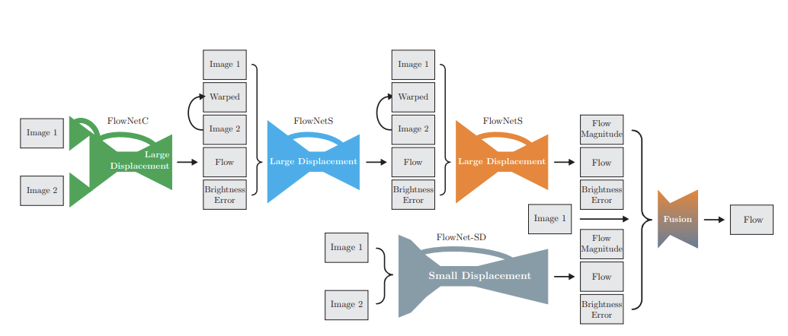
FlowNet and FlowNet2
Dosovitskiy, Alexey, et al. "Flownet: Learning optical flow with convolutional networks." Proceedings of the IEEE international conference on computer vision. 2015.
Ilg, Eddy, et al. "Flownet 2.0: Evolution of optical flow estimation with deep networks." Proceedings of the IEEE conference on computer vision and pattern recognition. 2017.

Slide 9
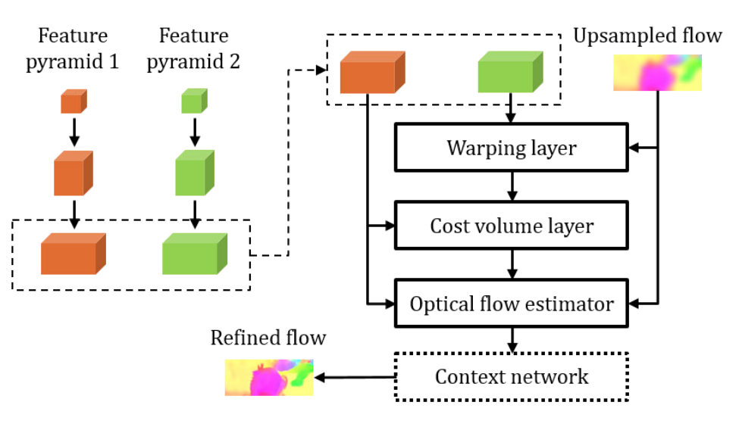
PWC-Net
Sun, Deqing, et al. "PWC-Net: CNNs for optical flow using pyramid, warping, and cost volume." Proceedings of the IEEE Conference on Computer Vision and Pattern Recognition. 2018.

Slide 10
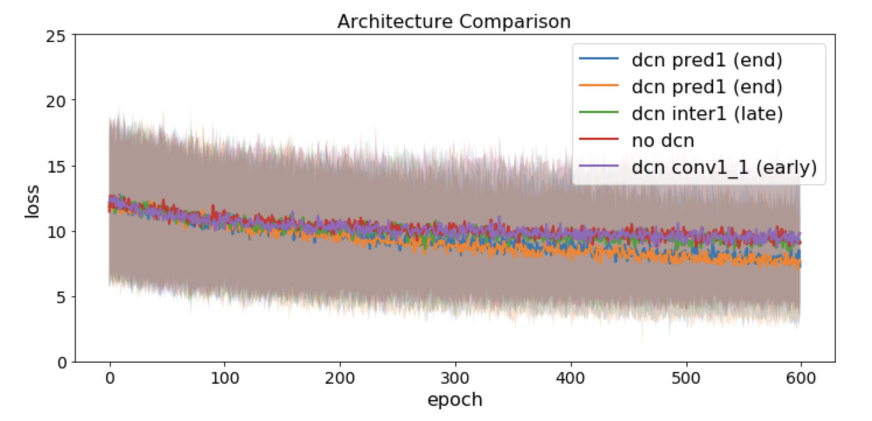
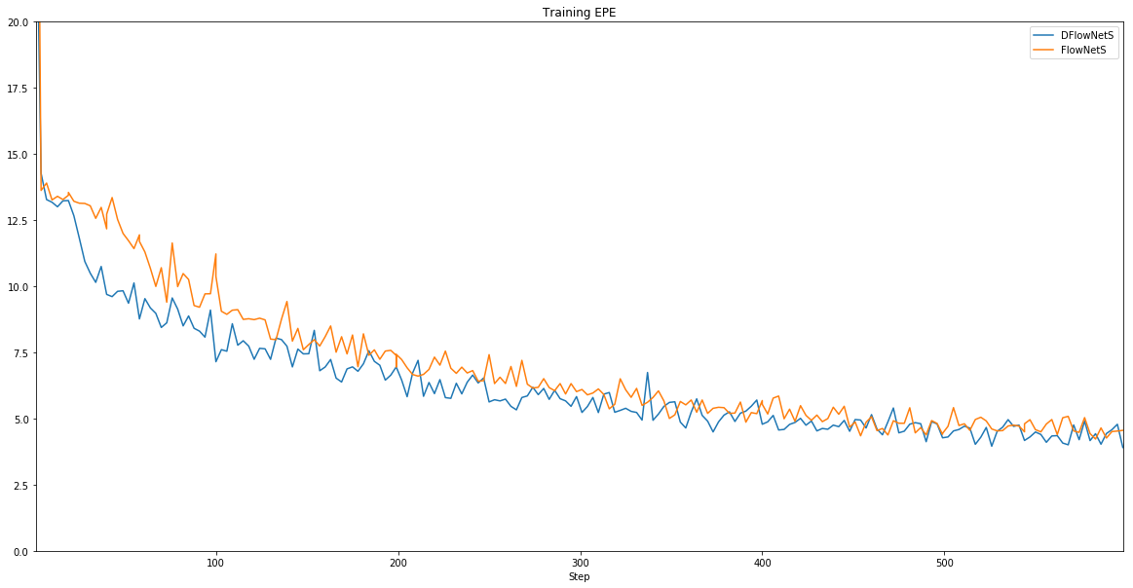
DCNs have some effect at end layers
Toy FlowNet Model + DCN
FlowNet + DCN
DCN at last layer- lower training EPE
DCN at last layer - lower validation EPE

Slide 11
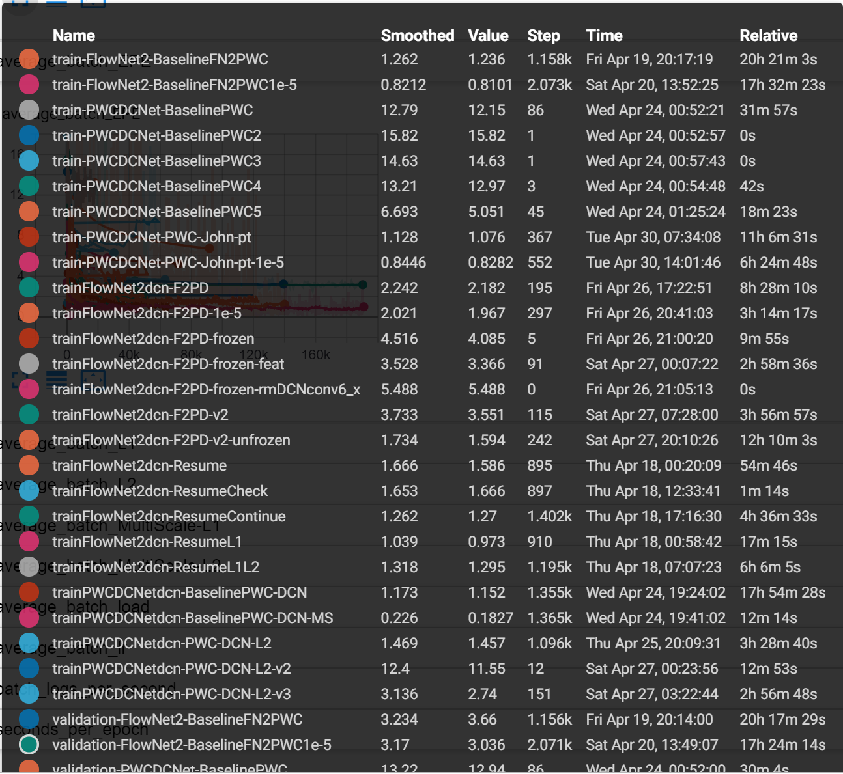
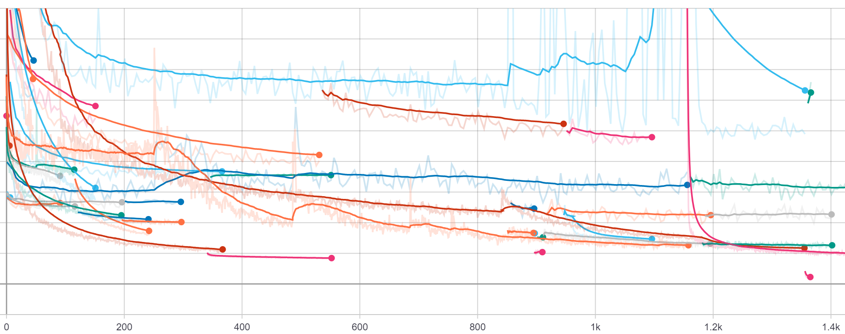
Some of our training...

Slide 12
Our Network Architecture (F2PD-JJN)
+
FLOWNET2
+
PWCNET
+
DCNs
Further ablation studies...
Notes:
John - discuss PWC-Net + DCNs

Slide 13
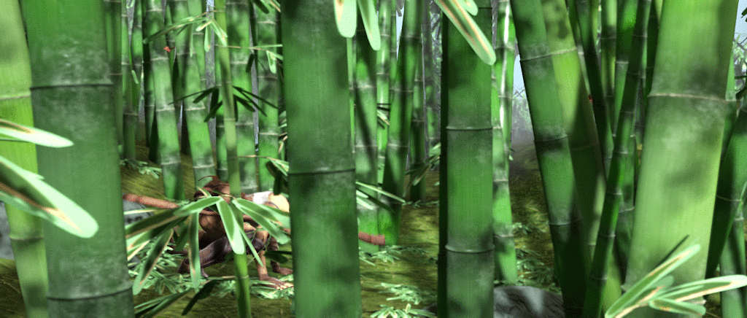
Test Sample

Slide 14
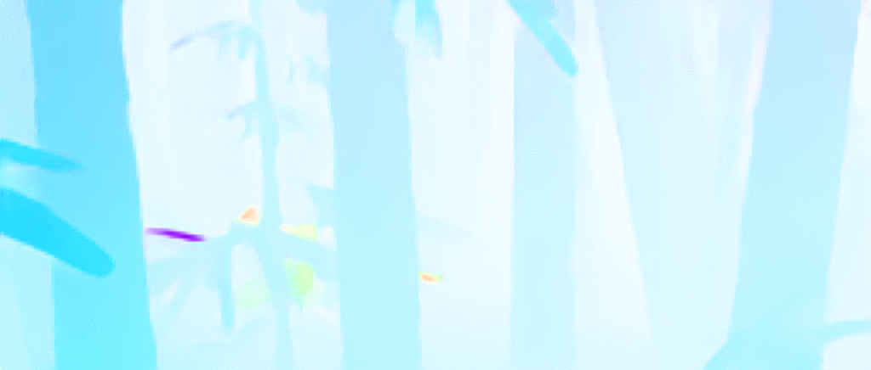
Our Results

Slide 15
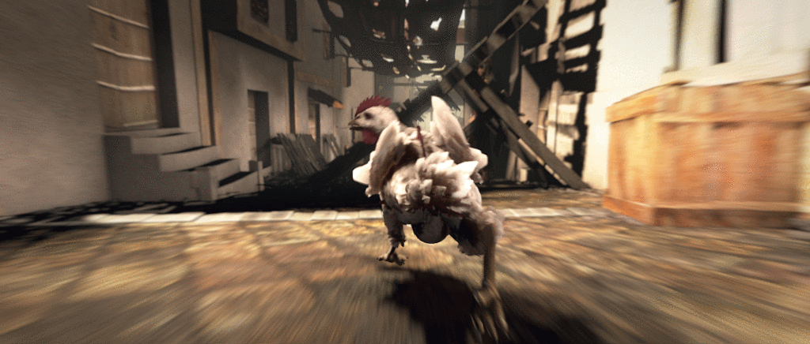
Market_4 Test

Slide 16

Our Network

Slide 17
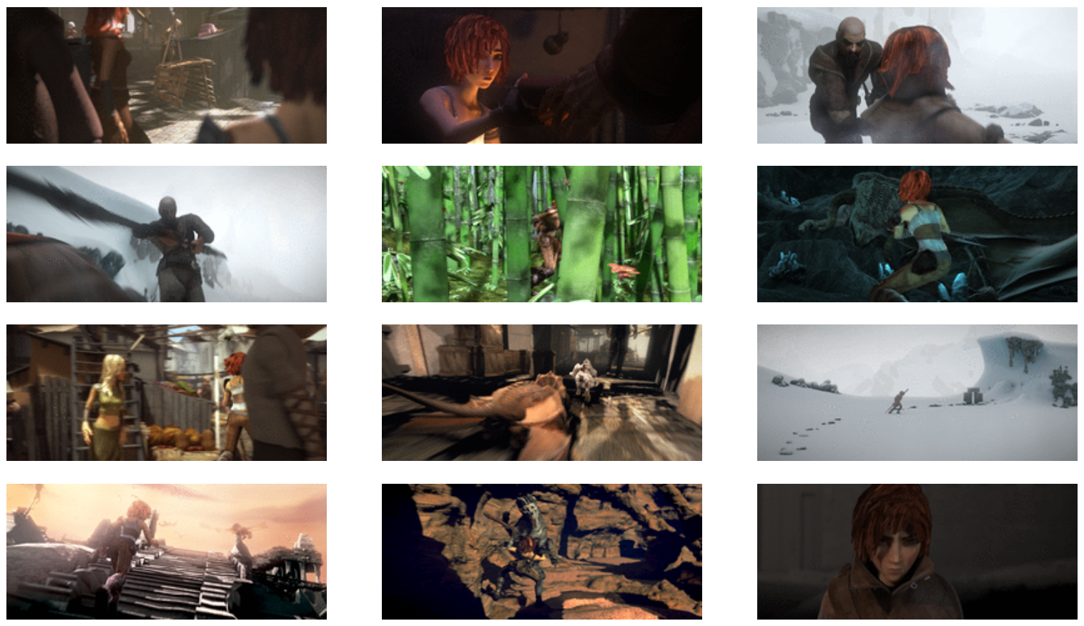
MPI-Sintel Test

Slide 18
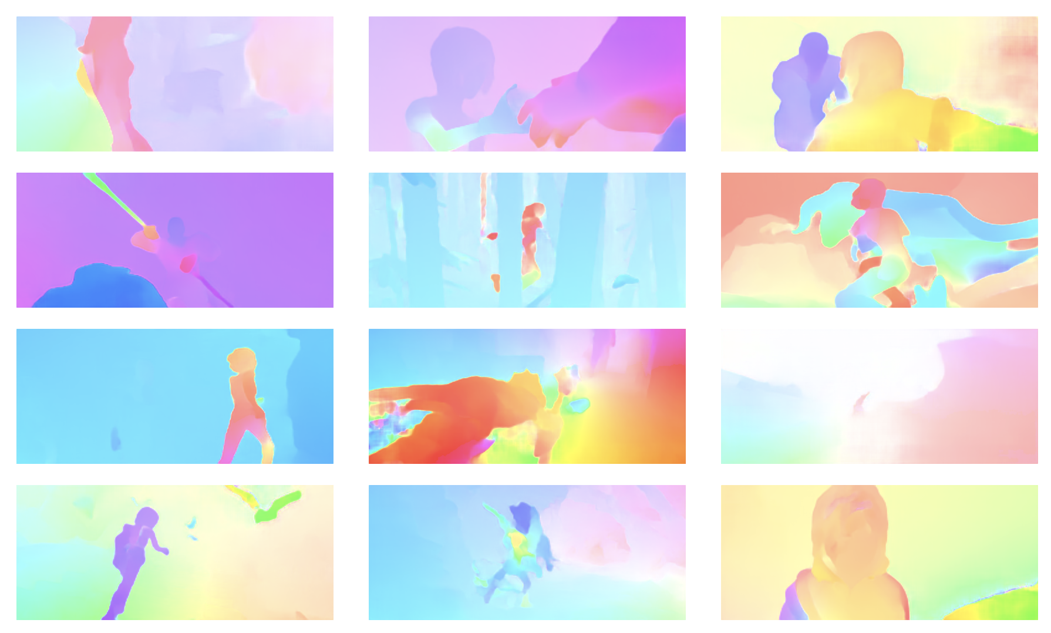
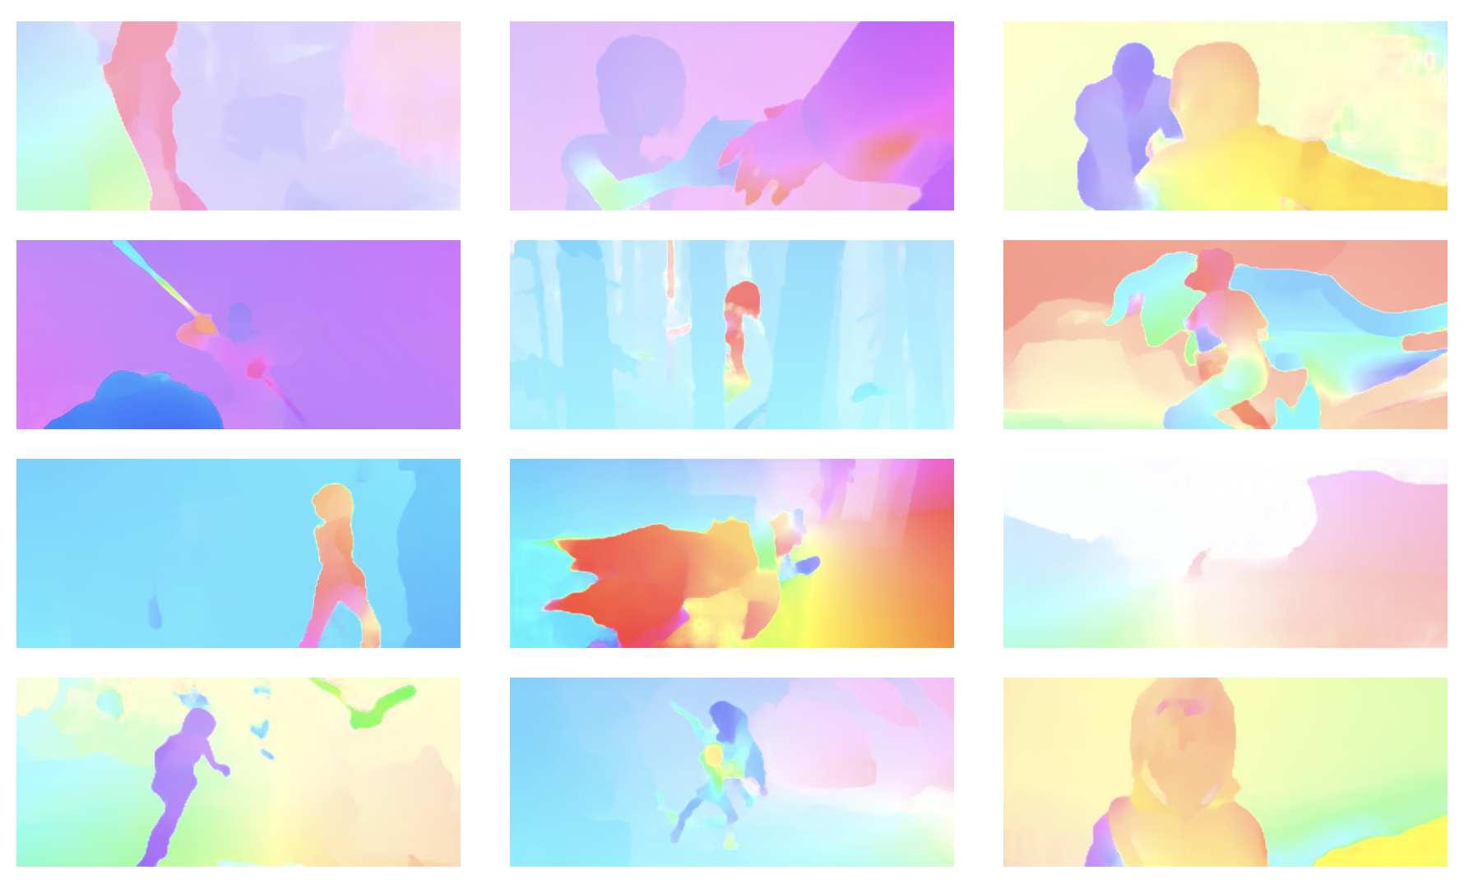
MPI-Sintel Results
OUR NETWORK (Rank #35)
SELFLOW
(Rank #1)

Slide 19
Benchmark/Ranking
 | EPE all | EPE matched | EPE unmatched | d0-10 | d10-60 | d60-140 | s0-10 | s10-40 | s40+
GroundTruth [1] | 0.000 | 0.000 | 0.000 | 0.000 | 0.000 | 0.000 | 0.000 | 0.000 | 0.000
SelFlow [2] | 4.262 | 2.040 | 22.369 | 4.083 | 1.715 | 1.287 | 0.582 | 2.343 | 27.154
PWC-Net [20] | 5.042 | 2.445 | 26.221 | 4.636 | 2.087 | 1.475 | 0.799 | 2.986 | 31.070
F2PD_JJN [36] | 5.530 | 2.819 | 27.639 | 4.539 | 2.452 | 2.063 | 0.918 | 3.113 | 34.257
FlowNet2 [57] | 6.016 | 2.977 | 30.807 | 5.139 | 2.786 | 2.102 | 1.243 | 4.027 | 34.505
Notes:
D - distance to occlusion boundary
S - velocity

Slide 20
Next Steps
Incorporate domain knowledge
SelFlow - currently #1 on Sintel leaderboard
PWC-Net - good example of few parameters
Robust Vision Challenge - aggregate score over multiple datasets
KITTI Dataset - moving cars, moving objects

Slide 21
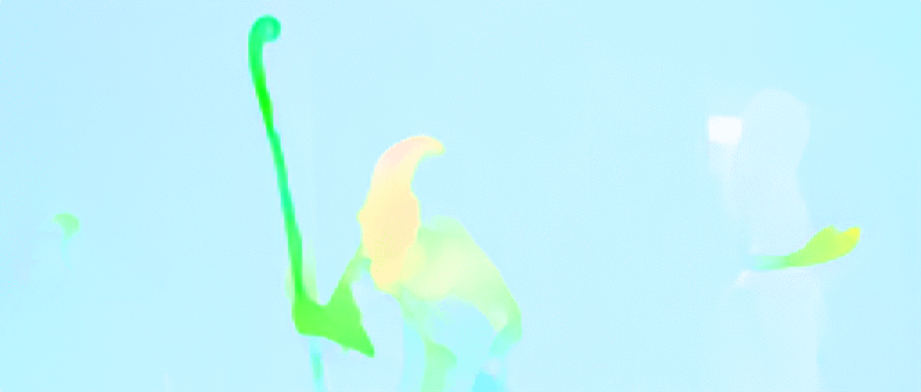
Thank You
Prof. Iddo Drori
TAs: Fan Wu, Linyong Nan, Yueqi Wang, Darshan Thaker

Slide 23
Background: DCNs
Notes:
Convolutional neural networks (CNNs) are inherently limited to model geometric transformations due to the fixed geometric structures in their building modules. DCNs are based on the idea of augmenting the spatial sampling locations in the modules with additional offsets and learning the offsets from the target tasks, without additional supervision. The new modules can readily replace their plain counterparts in existing CNNs and can be easily trained end-to-end by standard back-propagation, giving rise to deformable convolutional networks. Extensive experiments validate the performance of our approach. For the first time, we show that learning dense spatial transformation in deep CNNs is effective for sophisticated vision tasks such as object detection and semantic segmentation.
-Deformable Convolutional Networks (arXiv:1703.06211v3)

